Slide 1




Data Analytics Approach by Ibrahim Parkar

Slide 2
Agenda
Model Development
Introduction
Data Exploration
Interpretation

Slide 3
Introduction
Problem Statement:
Sprocket Central Pty Ltd, a medium-sized bikes & cycling accessories organization, has provided a new list of 1000 potential customers along with their demographic information. However, these customers do not have any prior transaction history with the organization.
Our Goal:
The marketing team at Sprocket Central Pty Ltd aims to gain valuable customer insights that can optimize resource allocation for targeted marketing efforts. By focusing on high-value customers, they seek to improve overall business performance.

Slide 4
Introduction
Dataset Overview:
We have been provided with three datasets:
•Customer Demographic: Contains information about customer demographics.
•Customer Addresses: Includes customer address details.
•Transactions Data: Provides data on past transactions.
Steps Taken:
To address the task, we have performed the following steps:
•Data Cleaning: Ensured data quality by cleaning and removing any inconsistencies.
•Data Transformation: Combined the transactions, customer demographic, and customer address data for comprehensive analysis.
•Data Exploration: Explored the data to uncover meaningful insights and patterns

Slide 5
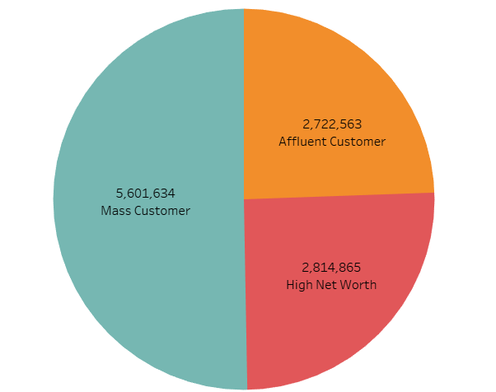
Data Exploration
Total Profit based on Wealth Segment of customers
Insights:
The mass customer are the most profitable segment among the three segments as nearly 50% of the profit is made by this segment.

Slide 6
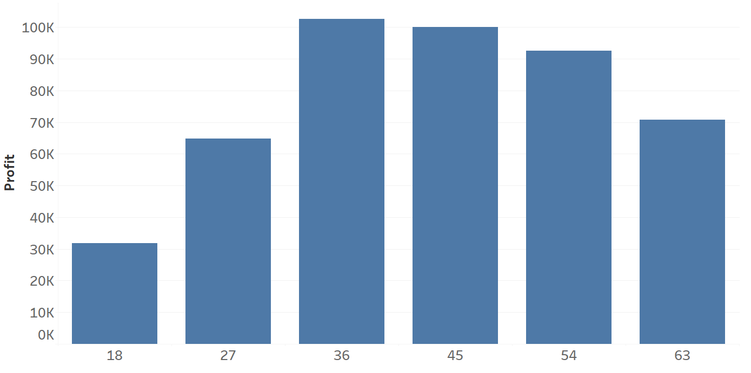
Data Exploration
Total Profit based on different Age Groups
Insights:
The customers between 27 to 54 age are the most profitable in terms of recent transaction history with more than 80k profit.

Slide 7
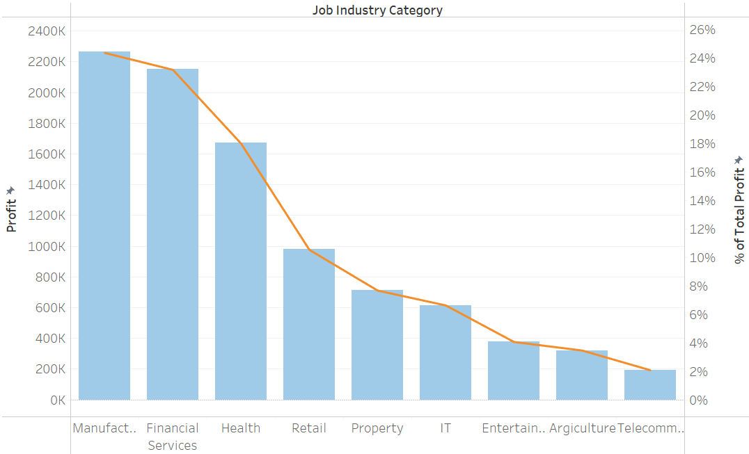
Data Exploration
Total Profit based on customers Industry
Insights:
The customers related to Financial Service and Manufacturing showing most profit with 20 lacs + profit.

Slide 8
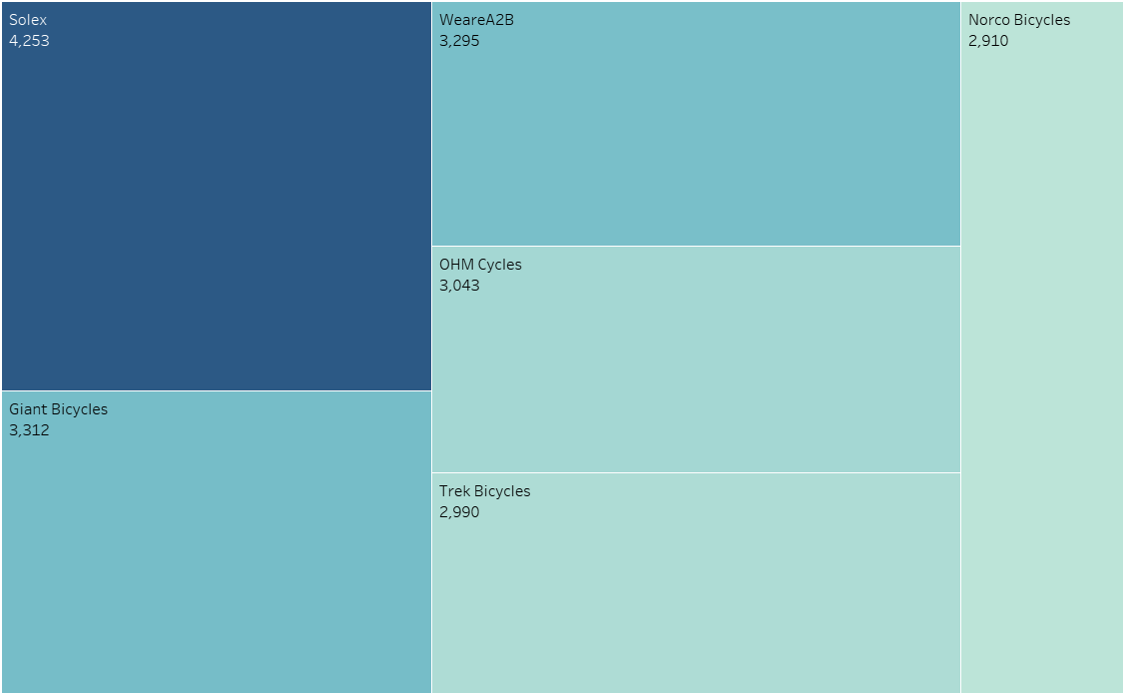
Data Exploration
Most purchased brands among customers
Insights:
Customers buys more Solex brand among the other brands with transaction count of more than 4000.

Slide 9
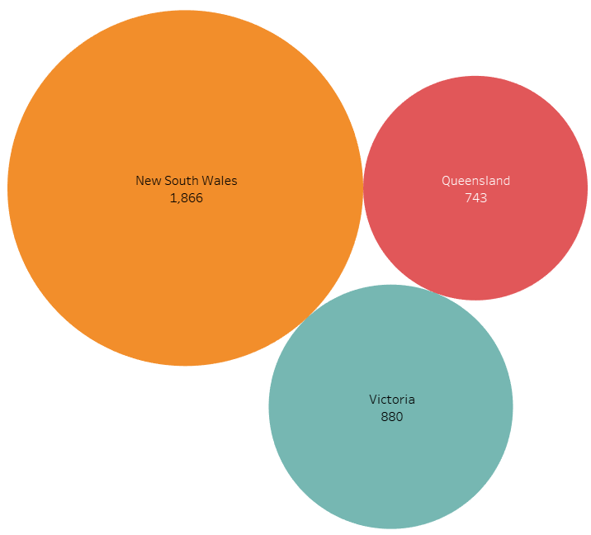
Data Exploration
Total Profit based on customers Industry
Insights:
Customers living in New South wales are the most profitable customers with more than 50% profit among the other States.

Slide 10
Thank you for your time

